Slide 1
A Review Report
on new SO₂ emission norms
August 2021
TPRM Div. CEA

Slide 2
Background
In December 2015, MOEF&CC first time introduced environmental emission standards for controlling SO2, NOx & Mercury emissions from coal-based TPPs under the Environment (Protection) Act, 1986.
SCR technology is not proven in Indian coal and 300 mg/ NM3 can not be achieved by combustion modification, CEA took up the matter with MOP & MOEF&CC and finally the NOx norms was revsied from 300 mg/Nm3 to 450 mg/NM3.
Post 2015, Thermal power stations had to upgrade ESP, implement the SO2 control technology & combustion modification and a detailed phasing plan was prepared to implement FGD by 2024.
The detailed phasing plan prepared by CEA in consultation with all stake-holders and was sent to MoEF&CC in June,2017.
However, the time line was squeezed by MoEF&CC to December, 2022.
CEA started monitoring the implementation of measures to comply with new norms. More than 90% TPPs are installing wet lime stone based FGD system as it is economical.
It was found that thermal power plants are facing many issues/challenges during the implementation of FGD system.

Slide 3
Challenges in Implementation of FGD
Till the end of 2015 no SO₂ norms were applicable, thus FGD manufacturing capacity was almost nonexistent in the country.
FGD technology being new to our country, there are at present limited vendors with limited capacity to supply FGD components. Therefore, there is an availability constraint.
A sudden surge of demand has arisen as all thermal generating units, about 470 running units of 180 GW capacity, have to implement FGD system in one go. Proper planning was not there for development of infrastructure to meet the demand surge.
Although India has the manufacturing capability of more than 70% FGD components, it depends on the imports from other country as manufacturing capacity is insufficient to cater to huge demand in a short period of time.
Balance 30% of FGD component is not manufactured in India. Thus, import from other countries is the only option and to create a manufacturing capability of these items in India would take few years.

Slide 4
Challenges in Implementation of FGD (contd.)
A huge foreign exchange for importing technology, equipment and skilled manpower from other countries shall be required.
Placing order for installation of FGD in all the plants simultaneously without ascertaining its performance in Indian condition may not be a proper decision.
Thus, no time for fine tuning of the specification is possible, considering the implementation time of about 36 months and all the orders being placed in one go, targeting December 2022 deadline.
Due to huge gap in demand and supply of FGD equipment, prices are escalating exorbitantly and it can also lead to market manipulation.
Impact of Covid-19 pandemic on planning, placing of order, supply chain of equipment and installation of FGD is severe.
Increasing cost of electricity.

Slide 5
CEA paper on
Plant Location Specific Emission Standards

Slide 6
Plant Location Specific Emission Standards
Background
To overcome all the above issues /challenges being faced by power industry, CEA prepared a paper on plant location specific emission standards and suggested a graded action plan for FGD implementation in TPP.
The report was prepared based on the ambient air quality data received from various power stations, air quality data published by CPCB, satellite images of atmospheric SO₂ from NASA and study conducted by IIT Kanpur.
The ambient air quality can be made as the guiding factor for formulating emission control strategy. The gradation of ambient air quality would be helpful in prioritizing the installation of emission control equipment in a phased manner.

Slide 7
Plant Location Specific Emission Standards
Thermal Power Plant Emissions
Thermal Power Plant emissions have both local and global impact. Global impact is mostly due to the production of greenhouse gases CO₂ and locally (country specific) it contributes large quantity of bottom ash, fly ash (PM) and some emissions of SO₂/NOx.
Stack height is designed to take care of the dispersion of emissions from thermal power plants. Its impact can be seen from the ground based Ambient Air Quality measurements carried in the immediate vicinity of the power plants.
For ascertaining Dispersion of Emissions from the stack, the modelling studies and the satellite imagery are useful tools. Satellite imagery indicates the hot spots which would need to be effectively taken care of on priority basis.

Slide 8
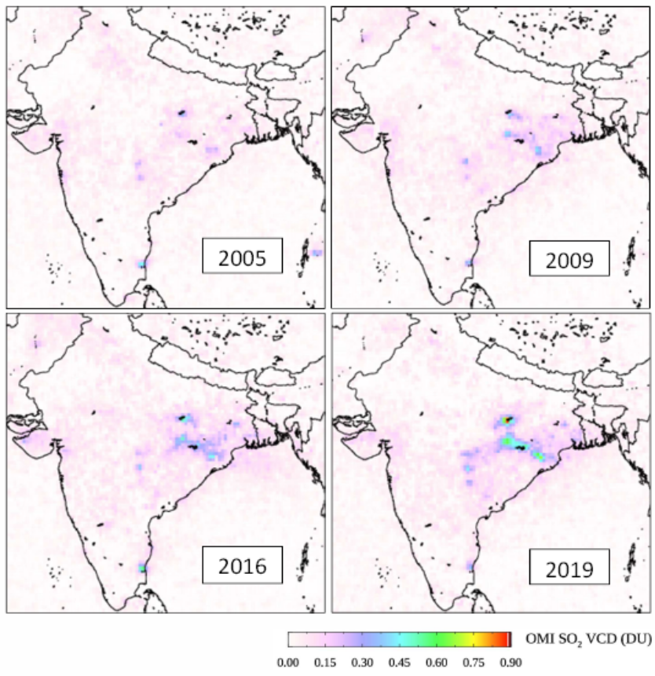
Plant Location Specific Emission Standards
Satellite Imagery of SO₂ Emissions
TPRM, CEA Division had contacted Nasa for providing the latest satellite imagery for SO₂ atmospheric levels and Nasa has shared the images for the period 2005 to 2019.
The figure indicates the changes in the Vertical Column Density of atmospheric SO₂ from year 2005 to 2019. It shows that the SO₂ hot spots are concentrated in small clusters in states of Odisha, WB, Jharkhand, Chhattisgarh, Maharashtra, Tamil Nadu and Gujarat, etc. having incidentally large capacities of Thermal Power Plant, which would need to be effectively taken care off on priority basis.
Satellite images indicates the concentration of SO2 at certain height (900 m and above) and not ground level SO2 in the area. Hence, Ground Air Quality measurements play an important role.

Slide 9
Plant Location Specific Emission Standards
Air Quality Dispersion Modeling Study, Jan 2020
The Study was conducted by Prof. Mukesh Sharma, Dept. of Civil Engineering, IIT Kanpur on the behalf of Private Power Producer.
Scope of the Study
Modeling Study on the dispersion of pollutants, mainly SO₂ emission from the Talwandi Sabo Thermal Power Plant, Punjab.
Estimating an increase in SO₂ and sulfate at ground level concentration using dispersion model.
Study Conclusions
The model computed SO₂ peak concentration is in the month of April 45.9μg/m³. The peak contribution towards Delhi was 40μg/m³ at a distance of about 2.0km and drops sharply to less than 1μg/m³ at a distance of 40km from the plant. Thus beyond 40km the impact of SO₂ becomes insignificant.
The NO₂ modelled peak concentration was in April at 52μg/m³. The peak contribution towards S-E direction was 45μg/m³ at a distance of 2.5km and drops sharply to less than 1μg/m³ at a 40km distance from the plant. Thus, beyond 40km the impact of NO₂ becomes insignificant.

Slide 10
Plant Location Specific Emission Standards
Air Quality Dispersion Modeling Study, Jan 2020
Study Conclusions
Similarly, it has also been indicated that the 24-hourly mean peak concentration of SO4 was 2.18 μg/m3 in the S-E direction at 12 km which drops to 0.73 μg/m3 in S-E direction at a distance of about 250 km.
The 24-hourly mean peak concentration of NO3 was 0.41 μg/m3 in S E direction at a distance of about 12 km and it drops to less than 0.002 μg/m3 at a distance of about 250 km.

Slide 11
Plant Location Specific Emission Standards
Ambient Air Quality Data (CPCB, 2018)
The latest (CPCB,2018) Ambient Air Quality data (SO₂, NO₂, PM₁₀, PM_{2.5}) monitored at 745 Stations located across the country available then was analysed by CEA. Refer Annexure I of the report. (Data is available for 24 hr. average (min./max.) and annual average)
SO₂ ground based levels across the country were mostly within a range of 0-40µg/m³ (considered Good as per CPCB standards) and similar trend with some exceptions was seen in the case of NO₂ levels.
MoEF&CC has adopted air quality standards for the country and defined the AQI index for categorizing the Ambient Air Quality (“good” to “severe”) based on the various sub-indices concentration levels as indicated below.
The latest CPCB,2019 data
 | Good | Satisfactory | Moderately Polluted | Poor | Very Poor | Severe
SO₂ (µg/m³) | 0-40 | 41-80 | 81-380 | 381-800 | 801-1600 | 1600+

Slide 12
Plant Location Specific Emission Standards
Ambient Air Quality of Thermal Power Plants
In June 2020, CEA sent request to all the Thermal Power Generating Companies to furnish ambient air quality data (PM/SO₂/NOx) at least for past one year collected from the AAQMS located in their plants.
The data was collected from central sector, state sector and private sector power plants.

Slide 13
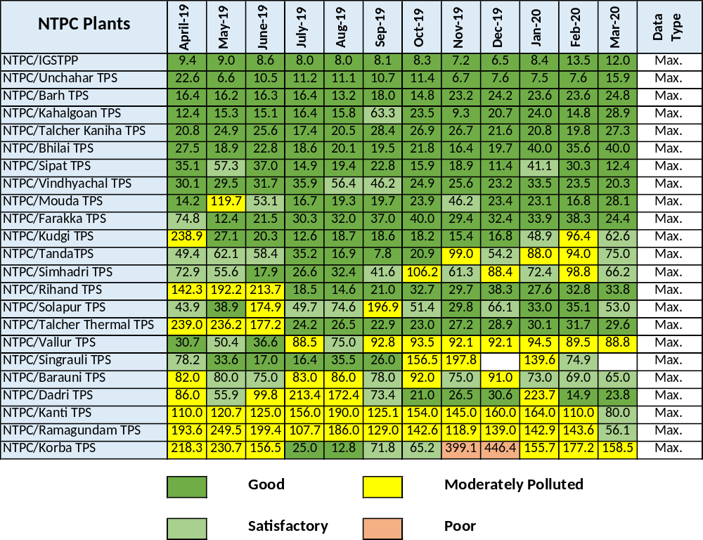
Plant Location Specific Emission Standards
Ambient Air Quality, SO₂ Levels (µg/m³) Central Sector Plants

Slide 14
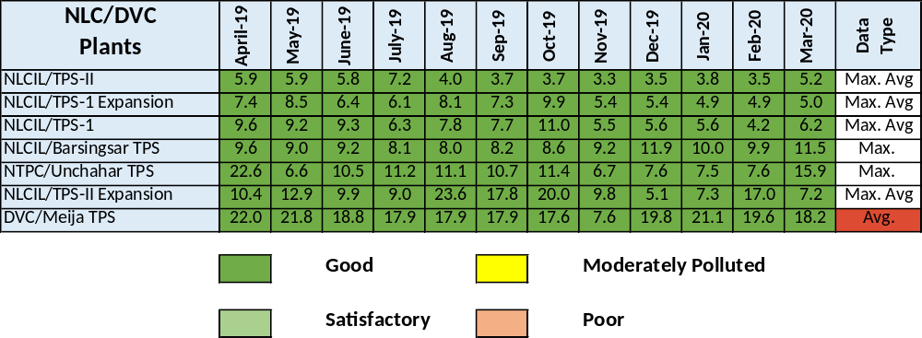
Plant Location Specific Emission Standards
Ambient Air Quality, SO₂ Levels (µg/m³) Central Sector Plants

Slide 15
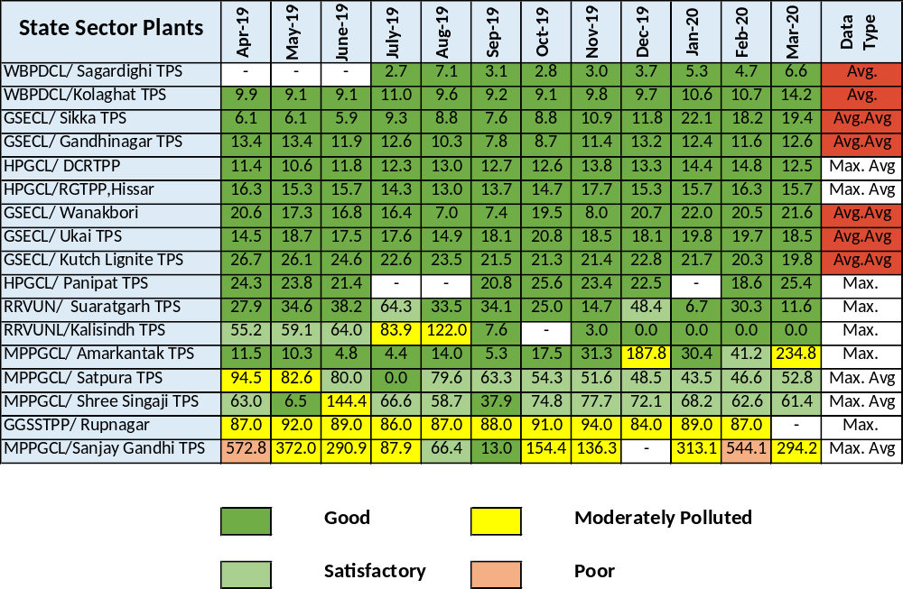
Plant Location Specific Emission Standards
Ambient Air Quality, SO₂ Levels (µg/m³) State Sector Plants

Slide 16
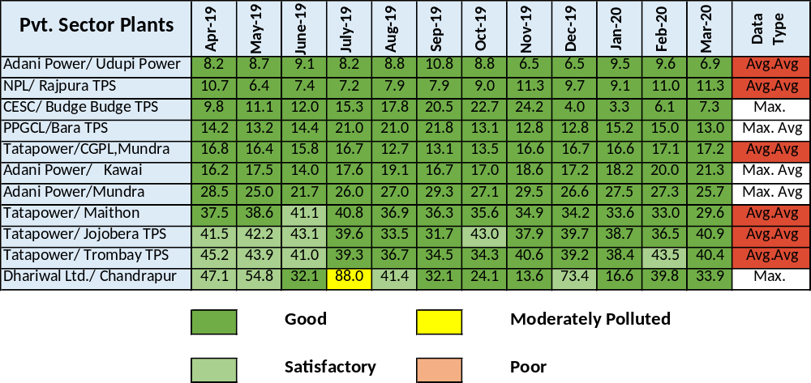
Plant Location Specific Emission Standards
Ambient Air Quality, SO₂ Levels (µg/m³) Private Sector Plants

Slide 17
Plant Location Specific Emission Standards
Ambient Air Quality in Thermal Power Plants
The data was analyzed for an installed capacity of 86,272MW by CEA and has been tabulated as below. Plant capacity is categorized considering the maximum and average value of SO₂ levels in their vicinity.
Thermal Power Plant capacity categorized considering the average value of SO₂ in their vicinity.
SO₂ Avg. (μg/m3) | 0-10 | 11-15 | 16-20 | 21-25 | 26-30 | 31-35 | 36-40 | >40
Thermal Capacity | 23,330 | 16,770 | 24,954 | 10,320 | 2,700 | 2,520 | 2,527 | 1,930
Percentage | 27.43% | 19.72% | 29.34% | 12.13% | 3.17% | 2.96% | 2.97% | 2.27%

Slide 18
Plant Location Specific Emission Standards
Ambient Air Quality in Thermal Power Plants (contd.)
As per the above data, immediate action may have to be considered for a capacity of about 33% and for 15% in the next phase.
Thermal Power Plant capacity categorized considering mainly the maximum levels of SO₂ in their vicinity averaged over a period of one year.
SO₂ Max. (μg/m3) | 0-10 | 11-15 | 16-20 | 21-25 | 26-30 | 31-35 | 36-40 | >40
Thermal Capacity | 10,920 | 10,160 | 7,560 | 6,340 | 9,834 | 10,380 | 2,528 | 28,550
Percentage | 12.66% | 11.78% | 8.76% | 7.35% | 11.40% | 12.0% | 2.93% | 33.09%

Slide 19
Merits of Phased Execution
Plant Location Specific Emission Standards
Various technologies are available to control the Flue Gas Emissions and their suitability and efficacy needs to be ascertained in the Indian conditions.
Phasing will help in better understanding the impact of the emission control equipment on their effectiveness and shall give time for future course correction.
Implementation of emission control measures in all the Power Plants simultaneously may not be the best option to adopt and will inevitably lead to the following which is not in the overall interest of the country.
Lack of time for developing indigenous manufacturing facility,
Resorting to import of equipment thus creating market for mainly foreign companies,
Huge investment of over one lakh crore required. Majority of which will lead to the foreign exchange drain for outsourcing of new technology, skilled manpower and equipment as there is lack of time to develop the facility indigenously.

Slide 20
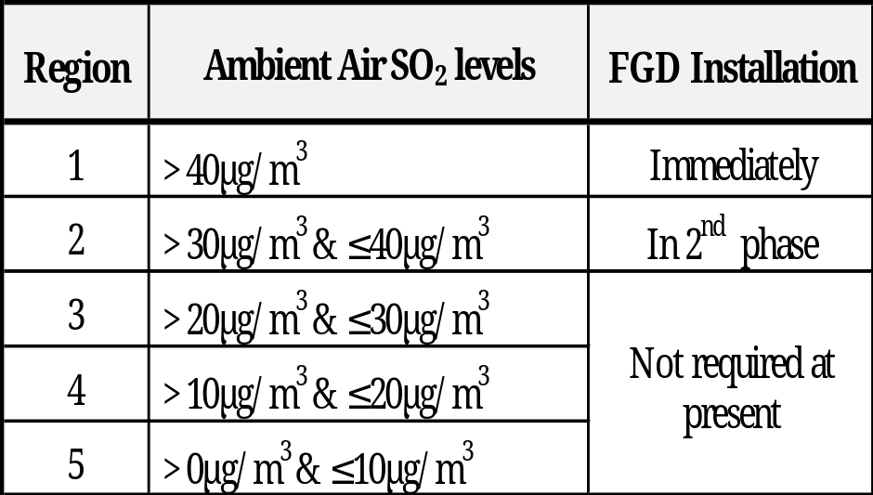
Plant Location Specific Emission Standards
Recommendations:
To mitigate the challenges faced by the New Emission Norms following measures can be adopted.
1. Uniform Ambient Air Quality across the country and not the uniform emission norms for Thermal Power Plants. Implementing uniform emission norms of TPS may result in different air quality at different location. Identical norms for Thermal Power Plants located in critically polluted area and in areas where air quality is good doesn’t look to be proper as additional costs are involved. Aim should be to achieve Uniform Air Quality throughout the country.
It is proposed to implement FGD for the Thermal Power Plants region-wise as given in the table below:
In areas where the development is high, the atmospheric air quality is poor and is prone to serious atmospheric pollution problems, strict control of emissions shall be required in such key areas for TPS as categorised under Region 1.

Slide 21
Plant Location Specific Emission Standards
Recommendations (contd.)
In next phase FGD to be implemented in the Power Plant which are under Region 2
Presently, no action shall be required for Power Plant those are under Region 3,4 & 5.
2. Graded Action Plan for adopting new emission norms rather than adopting a single deadline for large base of Thermal Power plants.
Unworkable time schedule will create market scarcity leading to import, jacked up prices unnecessary burden on power utilities. Graded Action Plan will help in utilizing the resources in effective manner and it will help in fine tuning the technology for local conditions.
Whereas, if the process of emission control in the country is completed in longer time frame (10-15 years) and considering in first phase Thermal Power Plants located in critically polluted areas, it will achieve tangible results in combating emissions and help in developing indigenous manufacturing base, skilled manpower in the country which shall take care of the local operating conditions.

Slide 22
Review Report on new SO₂ emission norms
The report was submitted to MOP in August, 2020.
After approval it was forwarded by MOP to MOEF&CC for consideration in January, 2021.
Thereafter, MOEFF&CC notified G.S.R.243(E) dtd.31.03.2021 for categorization of thermal power plant on the basis of their location.

Slide 23
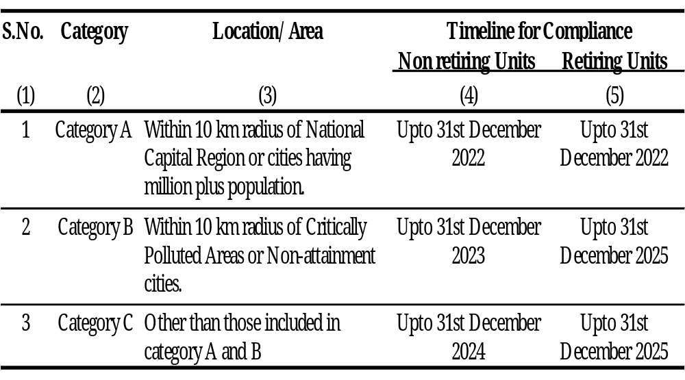
Review Report on new SO₂ emission norms
MOEF&CC notification dated 31.03.2021
Thereafter, MOEFF&CC notified G.S.R.243(E) dtd.31.03.2021, that the emission compliance would mean all the plant emission norms (2015) for PM/SO2/NOx are to be met by the specified timeline as per Category, A,B or C, any deviation in the above norms beyond the timeline would be liable for the levy of emission compensation (EC).

Slide 24
Review Report on new SO₂ emission norms
Analysis of MOEF&CC notification dated 31.03.2021
Presence of SO₂ or NOx in the ambient air in the area has not been considered. It is well known that there is issue of PM10 or PM2.5 in many cities but there may not be any issue regarding level of SO₂ or NOx.
Thus ambient air quality (AQI) has not been made as the guiding factor for formulating the categorization. On the other hand the area where ambient air quality is actually critical in terms of SO2 or NOx level may not be located in cities/ areas as specified, there is a fair possibility that these areas may fall under category C.
Due to paucity of implementation time, any new technology which is being implemented in category A shall be repeated in category B without seeing its performance in category A. Therefore, sufficient time shall be required for fine tuning the performance of FGD already in operation. However, there is not enough time in between timeline of category A and B.

Slide 25
Review Report on new SO₂ emission norms
Analysis of MOEF&CC notification dated 31.03.2021
About 150 GW plus capacity of TPPs is under Category C (exact number of units and capacity will be known only after completion of categorization work by a Task Force constituted for this purpose) and sufficient time will be required so that they can modify the order seeing the performance of FGD in category A.
After commissioning of FGD system almost 2-3 years are required for stabilization. Thus minimum 6 years’ time may be given from commissioning of TPP under Category A. Therefore timeline for category C shall be 2028 (considering 3 years for stabilization and 3 year for implementation).
Further, there will be huge demand of FGD equipment in 2028 which may create crisis in the FGD market in India. Therefore, it is suggested that all these units timeline may be spread in 2028, 2029, 2033 & 2034 according to their distance from million plus city/ critically polluted area/ Non Attainment city or on the basis of SO2 level in ambient air. If distance is 11-40 km, 41-70 km, 71-100 km and more than 100 km, timeline will be 2028, 2029, 2033 and 2034 respectively.
This will help in understanding the performance of the emission control equipment, their effectiveness and give a time for course of correction.
An unworkable time schedule is creating market scarcity leading to import, jacked up prices unnecessary burden on power utilities. The project cost for wet lime based FGD technology is varying between rupees 0.39 crore to 1.10 crore per MW, which is quite high, around 2.8 times.

Slide 26
Review Report on new SO₂ emission norms
Realistic time for installation
Orders placed by a major central power utility as early as in 2018 for 30 FGD units for a total capacity of 15 GW have on an average completed a time period of over 35 months, and some units have completed more than 40 months since the award, and not a single FGD has been commissioned so far.
These orders have been fairly distributed among five different major Indian vendors. The detailed evaluation of the progress of above orders shall help in understanding the roadblocks and estimating the existing capability of the EPC contractors in the country. Based on which a realistic time schedule for installation of FGD for 180 GW installed capacity can be planned.

Slide 27
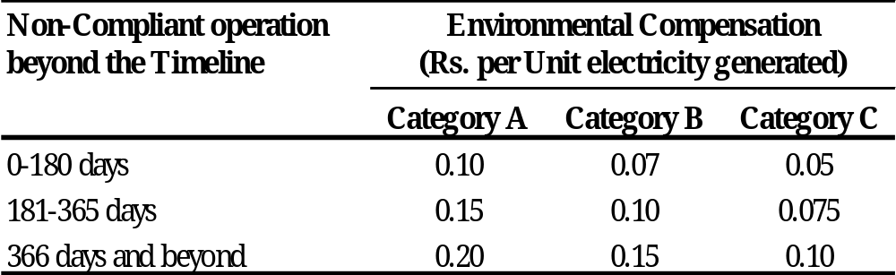
Review Report on new SO₂ emission norms
Analysis of MOEF&CC notification dated 31.03.2021
The environmental compensation (EC) max. per unit of 20 paisa (Category A), 15paisa (Category B) and 10paisa (Category C) which shall be levied for noncompliance beyond assigned time limit , takes into the consideration that the impact of thermal power plant emissions is location specific.
The merchant plants which are not operating in pass through regime may have the option, whether to go for the compliance or alternatively pay the EC
Non Compliant Operation beyond the timeline | Environmental Compensation
 | Category A |  | Category B |  | Category C
 | Rs./Unit | Rs. Cr* | Rs./Unit | Rs. Cr* | Rs./Unit | Rs. Cr*
0-180 days | 0.1 | 13.0 | 0.07 | 9.1 | 0.05 | 6.5
181-365 days | 0.15 | 20.0 | 0.1 | 13.3 | 0.075 | 10.0
One Year Delay Total |  | 32.9 |  | 22.4 |  | 16.5
366 days and beyond | 0.2 | 52.6 | 0.15 | 39.4 | 0.1 | 26.3
Two Year Delay Total |  | 85.5 |  | 61.8 |  | 42.8

Slide 28
Review Report on new SO₂ emission norms
Analysis of MOEF&CC notification dated 31.03.2021
It may be noted that CERC (Terms and Conditions of Tariff) Regulations, 2019 has provision for additional capitalization for installation of additional equipment for meeting new emission norms/ standards. However, these regulations do not include pass through of penalty levied on generating companies on account of the non – compliance of emission norms. Therefore, the entire penalty is likely to be borne by TPP concerned.
Environment compensation for a typical 500 MW unit operating at 60% PLF is calculated in table. It can be seen from table that EC is increasing after six months and further increasing in 2nd year. Environment compensation is 13 cr. in 1st six months, 20 cr. in next six months and 52.6 cr. in 2nd year for thermal plants under category A.
The amount 33 cr in 1st year and 52.6 cr in 2nd year onwards is quite high compared to the profit of a thermal power plant as EC will not be passed through in tariff instead may have to be borne by generating utilities.
Further, EC should not be made unending/perpetual. Instead it should be allowed for a limited period beyond which the plant may be asked to shut down. Otherwise the definite purpose of EC will be defeated.

Slide 29
Review Report on new SO₂ emission norms
Apprehension:
It may be noted that CEA, representative of thermal generating utilities, equipment manufacturers and suppliers/ vendors were not consulted during preparation of new environment norms 2015 about status/ requirement of the basic infrastructure for meeting SO2 norms by all TPP in one go which might be the main reason for missing the target 2017 or 2022.
The kind of infrastructure required for 180000 MW thermal capacity (470 units) can easily be understood from Table where the requirement (in Metric Tonnes) of materials for a typical FGD system for a 2x500 MW TPS is estimated.
Sl. No. | Major Materials | Materials Requirement
i | Cement | 25000
ii | Structural Steel | 15000
iii | Reinforcement steel | 5750-6000
iv | Stainless steel & plates | 350-400
v | Aluminum | 50-70
vi | Casting and Forgings | 200
vii | Casting and Forgings special alloy / Duplex stainless steel | 50
viii | Tube & Pipes | 600-800
xi | BQ Plates | 30
x | C276 clad/sheet for absorber | 350-375
xi | Titanium Gr2 for ducting | 300-350
Even after submitting the ground reality, issue & challenges of FGD implementation, CEA’s apprehension was undermined by not considering proposed graded action plan which may become the reason for missing target 2024 again.

Slide 30
Review Report on new SO₂ emission norms
Ambient Air Quality of Thermal Power Plants
The data was analyzed for an installed capacity of 123324 MW by CEA and has been tabulated as below. Plant capacity is categorized considering the maximum and average value of SO₂ levels in their vicinity.
Thermal Power Plant capacity categorized considering the average value of SO₂ levels in their vicinity.
SO₂ Avg. (μg/m3) | 0-20 | 20.01-40 | 40.01-80 | 80.01-380 | 380.01-1600 | >1600
Thermal Capacity | 92256.5 | 27287.5 | 2940 | 840 | 0 | 0
Percentage | 74.8 | 22.12 | 2.38 | 0.68 | 0 | 0

Slide 31
Review Report on new SO₂ emission norms
Ambient Air Quality of Thermal Power Plants
Thermal Power Plant capacity categorized considering mainly the maximum levels of SO₂ in their vicinity averaged over a period of one year.
SO₂ Max. (μg/m3) | 0-20 | 20.01-40 | 40.01-80 | 80.01-380 | 380.01-1600 | >1600
Thermal Capacity | 37870 | 43914 | 26310 | 15230 | 0 | 0
Percentage | 30.70 | 35.60 | 21.33 | 12.34 | 0 | 0
As per the above data, immediate action may have to be considered for a capacity of about 12%.

Slide 32
Review Report on new SO₂ emission norms
The chemical equations:
One mole CO2 is being generated by absorption of one mole of SO2 in all desulphurization process.
Additional 0.5% CO2 will be produced to neutralize SO2. The coal consumption is also expected to increase up to 1 % (due to APC) depending on the FGD technology and Green House Gas (CO2) will be released additionally due to increased coal consumption.
Thus global warming and Climate Change shall be worsen further with the implementation of FGD.
The increased APC also reduces the efficiency of power plants.
Wet lime FGD technology
a.CaCO3(s) + SO2(g) → CaSO3(s) + CO2(g)
b.Ca(OH)2(s) + SO2(g) → CaSO3(s) + H2O(l)
c.CaSO3(aq) + 2H2O(l) + ½O2(g) → CaSO4·2H2O(s) (Gypsum)
Dry Sorbent Injection (DSI) FGD technology
a. 2NaHCO3(s) + heat → Na2CO3(s) + H2O(g) + CO2(g)
b. Na2CO3(s) + SO2(g) +1/2(O2)→ Na2SO4(s) + CO2(g)
c. Na2CO3(s) + SO3(g) → Na2SO4(s) + CO2(g)
Seawater FGD technology
a. SO2(g) + H2O(l) + ½O2(g) → SO42−(aq) + 2H+
b. HCO3− + H+ → H2O(l) + CO2(g)

Slide 33
Review Report on new SO₂ emission norms
Implementation of FGD system randomly may causes followings:
Increase of CO2 emission
Increase of water consumption
Increase of auxiliary consumption thus burning more coal means further increasing CO2 emission.
Increase of limestone consumption means more mining, more transportation, thus more consumption of electricity and/or diesel. Therefore more coal burning and more dust pollution & CO2 emission.
Increase of transportation of Gypsum byproduct thus, further increasing CO2 emission.
Issue of low grade Gypsum disposal just like ash as no buyer for the same
Finally increasing cost of electricity thus more burden on common person

Slide 34
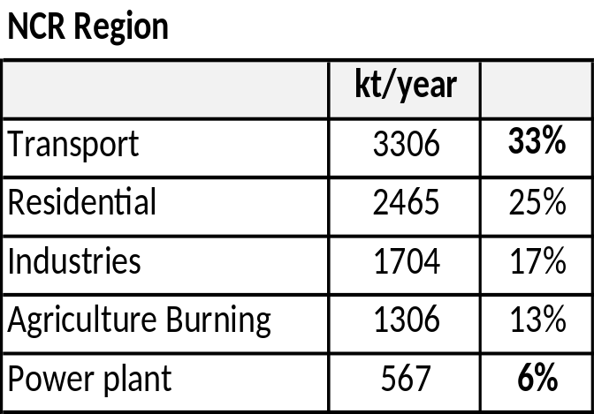
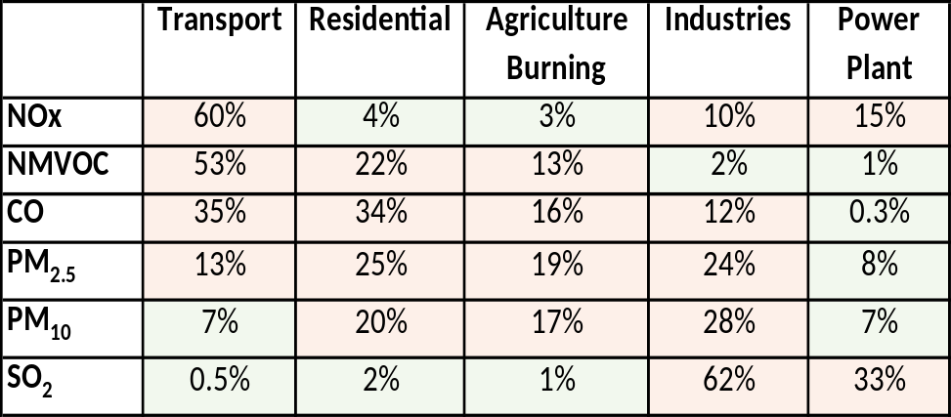
Review Report on new SO₂ emission norms
Source Apportionment of Delhi NCR Region TERI report (2018)
In a report prepared by TERI in 2018, the inventory of the various pollutant and their sources was estimated for Delhi and NCR region which is considered as a highly polluted area in the country.
The results are contrary to the general perception that power plants are the major contributors of pollution. The power plant contribution is only 26%, (567kt/yr) of the total industrial pollutant load (2271kt/yr). Further, Power plants contribute a mere 6% of the total annual pollutant (PM₁₀, PM_{2.5}, NOx, SO₂, CO and NMVOC) load in NCR.
Since then one of the major thermal power plant Badapur was closed down in the capital and the emission contribution of thermal power plants would have dropped sizably.

Slide 35
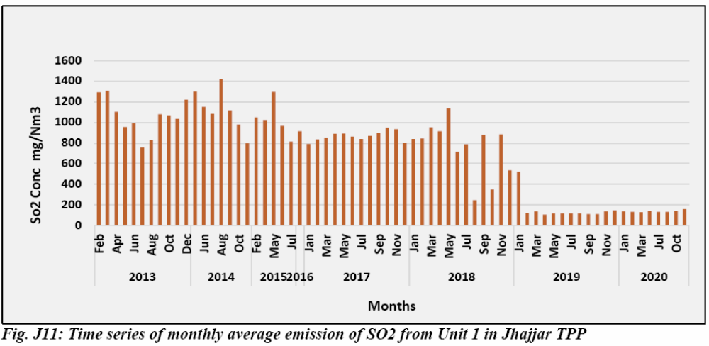
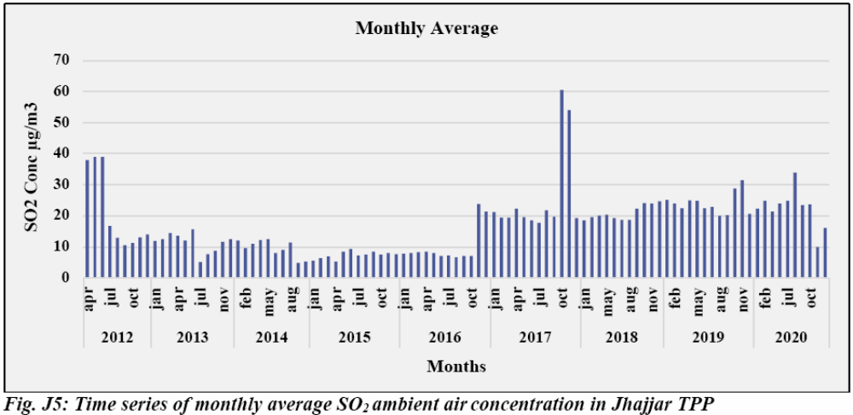
Review Report on new SO₂ emission norms
IITD Draft Report (June 2021)
The preliminary studies carried by IITD under CEA-IITD MOU was shared in the forum attended by CEA Thermal division.
In the IITD presentation, trends in emissions was analysed for few of the power plants. As per the data presented for Jhajjar Power Plant (2x660MW) in which the FGD was commissioned in 2019, the implementation of FGD has no impact on the ambient air quality of the plant.

Slide 36
AAQMS DATA -NTPC Dadri
Review Report on new SO₂ emission norms
Parameter | Week
 | 6th July – 12th July | 13th- 19th July | 20th – 26th July | 27th July – 2nd Aug | 3rd- 9th Aug | 10th -16th Aug | 17th-23rd Aug | 24th Aug-30th Aug | 31st Aug- 6th Sept | 7th -13th Sept | 14th-20th Sept
Load (MW) | 344 | 403 | 414 | 149 | 399 | 533 | 634 | 575 | 616 | 960 | 933
PM10.0 | 33.04 | 51.52 | 31.87 | 38.85 | 30.28 | 26.67 | 21.17 | 6.35 | 36.90 | 78.56 | 96.16
 | #DIV/0! | #DIV/0! | #DIV/0! | #DIV/0! | #DIV/0! | #DIV/0! | 22.04 | 24.52 | 48.99 | 110.51 | 138.38
 | 41.44 | 58.55 | 37.16 | 48.01 | 32.91 | 28.40 | 21.03 | 19.9 | 43.06 | 94.58 | 123.35
PM2.5 | 14.75 | 21.35 | 14.32 | 15.82 | 14.89 | 12.65 | 8.56 | 5.38 | 17.65 | 36.94 | 44.51
 | #DIV/0! | #DIV/0! | #DIV/0! | #DIV/0! | #DIV/0! | #DIV/0! | 10.35 | 11.72 | 21.87 | 48.25 | 56.15
 | 18.38 | 29.64 | 18.53 | 19.39 | 19.41 | 17.64 | 11.36 | 11.87 | 24.75 | 48.87 | 59.95
SOx | 8.76 | 8.94 | 8.56 | 8.69 | 8.24 | 8.18 | 8.84 | 8.99 | 9.14 | 9.66 | 10.95
 | 7.48 | 6.81 | 6.97 | 8.24 | 8.36 | 8.34 | 8.35 | 8.48 | 8.45 | 7.87 | 8.33
 | 10.47 | 9.80 | 9.15 | 9.03 | 8.87 | 8.76 | 10.06 | 10.87 | 11.11 | 11.80 | 12.24
NOx | 7.97 | 11.98 | 17.23 | 19.99 | 8.24 | 10.42 | 11.95 | 11.08 | 15.40 | 15.29 | 15.15
 | 10.46 | 9.71 | 8.97 | 10.53 | 15.68 | 10.89 | 13.58 | 13.06 | 13.67 | 12.92 | 13.96
 | 12.35 | 10.66 | 10.53 | 10.03 | 9.93 | 10.04 | 12.32 | 13.1 | 13.23 | 13.97 | 13.89

Slide 37
AAQMS DATA -NTPC Dadri
Review Report on new SO₂ emission norms
Parameter | Week
 | 21st-27th Sept | 28th Sept -4th Oct | 5th Oct-11th Oct | 12th -18th Oct | 19th Oct -25th Oct | 26th Oct to 1st Nov | 2nd Nov to 8th Nov | 9th Nov to 15th NOv
Load (MW) | 486 | 451 | 577 | 546 | 270 | 219 | 0 | 0
PM10.0 | 76.59 | 119.73 | 125.50 | 145.87 | 161.2 | 178.7 | 248.0 | 207.4
 | 102.17 | 178.16 | 219.51 | 231.58 | 279.0 | 289.3 | 371.4 | 282.7
 | 95.55 | 171.13 | 193.69 | 219.00 | 242.4 | 301.5 | 382.8 | 283.3
PM2.5 | 33.23 | 50.58 | 59.02 | 73.77 | 84.1 | 101.6 | 132.4 | 117.1
 | 40.06 | 67.47 | 91.99 | 109.30 | 124.1 | 145.6 | 195.3 | 165.8
 | 42.92 | 67.45 | 74.47 | 115.80 | 120.1 | 169.2 | 203.4 | 164.2
SOx | 10.39 | 10.32 | 11.17 | 11.03 | 11.0 | 7.8 | 10.5 | 11.9
 | 8.30 | 9.65 | 11.15 | 13.37 | 19.8 | 14.8 | 13.4 | 8.3
 | 12.35 | 12.65 | 9.71 | 9.71 | 10.8 | 11.0 | 11.5 | 8.2
NOx | 12.50 | 21.39 | 19.52 | 20.56 | 14.5 | 17.0 | 23.2 | 26.1
 | 13.86 | 13.34 | 18.19 | 17.56 | 18.8 | 17.1 | 18.0 | 20.2
 | 13.85 | 13.98 | 8.82 | 4.16 | 4.0 | 8.8 | 8.9 | 13.5

Slide 38
Review Report on new SO₂ emission norms
AQI During Shutdown at Dadri
Load AQI
Source: NTPC Ltd.
From the above AAQMS data trend it can be seen that, even after shutdown of all Coal fired units on 29th October’20, Ambient Air Quality (AQI) is either in same condition or has deteriorated. It shows no correlation of stack emission from Dadri plant and the Ambient Air Quality which requires further analysis.

Slide 39
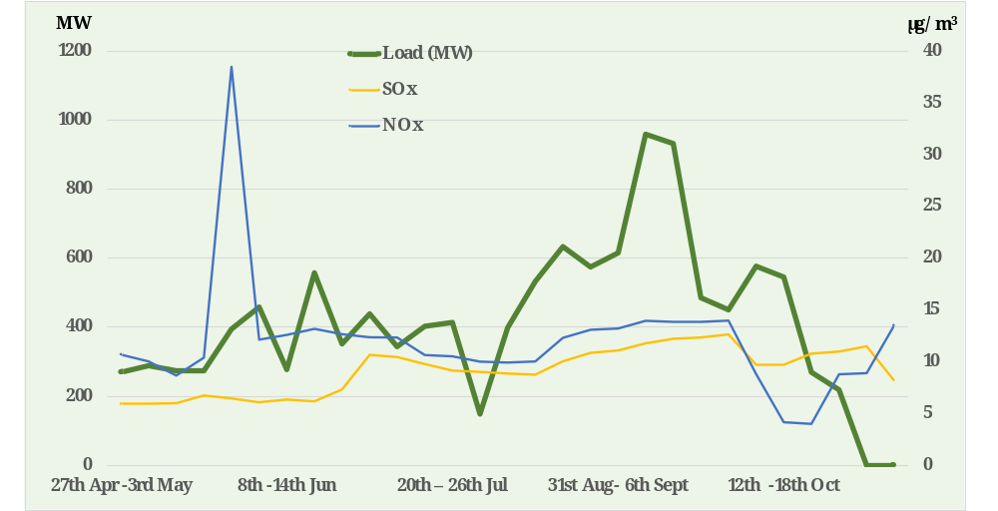
Ambient Air Quality SOx/Nox During Shutdown
at Dadri (Contd.)
From the above AAQMS data trend it can be seen that, the ambient levels of SOx and NOx are well below 40µg/m3 which is very good. Even after shutdown of all Coal fired units on 29th October’20, NOx is either in same condition or has deteriorated. However, SOx level is almost same.
Source: NTPC Ltd.

Slide 40
Review Report on new SO₂ emission norms
Way Forward
It is suggested that category C units timeline may be spread in four years i.e. 2028, 2029, 2033 & 2034 according to their distance from million plus city/critically polluted area/ Non Attainment city or on the basis of SO2 level in ambient air. This will help in understanding the performance of the emission control equipment, their effectiveness and give a time for course of correction.
Study may be conducted on SO2-reduction against CO2 increase in flue gas emission by FGD system including increase of pollution due to mining, transportation of limestone & gypsum. Accordingly exemption may be given to few thermal power plants where SO2 level in ambient air is very less compared to permissible limit.
A Task Force may be constituted compromising representative of MOP, MOEF&CC, NITI Aayog, CEA, CPCB, Utilities/Contractors/Manufacturers, they may review the category or create separate category for controlling SO2 emission from chimney for smooth implementation of new environment norms considering phased manufacturing program of FGD equipment under Atma Nirbhar Bharat.

Slide 41
Thank you

